Slide 1

SURFACE PLASMON RESONANCE IMAGING (SPRi)
Basics, State of the Art and Challenges
Department Of Physics
Presented by Moon Boro
Supervisor Prof. Sachin Kumar Srivastava
Co-Supervisor Prof Darshak Bhatt
Roll No : 25560002
Seminar 700

Slide 2
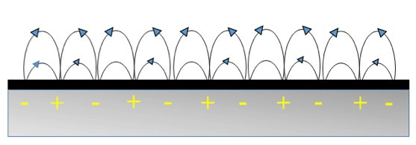

SURFACE PLASMON RESONANCE — THE PHENOMENON
What is SPR?
▸ A highly sensitive optical phenomenon at a dielectric–metal interface.
▸ Metal must have a negative real dielectric constant (typically Au or Ag).
How It Works
▸ p-polarized (TM) light strikes a prism
metal interface above the critical angle
total internal reflection.
▸ An evanescent wave penetrates a short distance into the metal.
▸ Free electrons at the metal surface oscillate collectively
Surface Plasmon Polaritons (SPPs).
▸ Resonant coupling between the evanescent wave and SPPs
sharp dip in reflected intensity.
Fig. 1 — Surface Plasmon Polaritons: collective oscillation of free electrons coupled to an evanescent EM field at the metal surface.
INTRODUCTION
02
Seminar

Slide 3
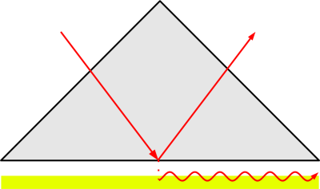
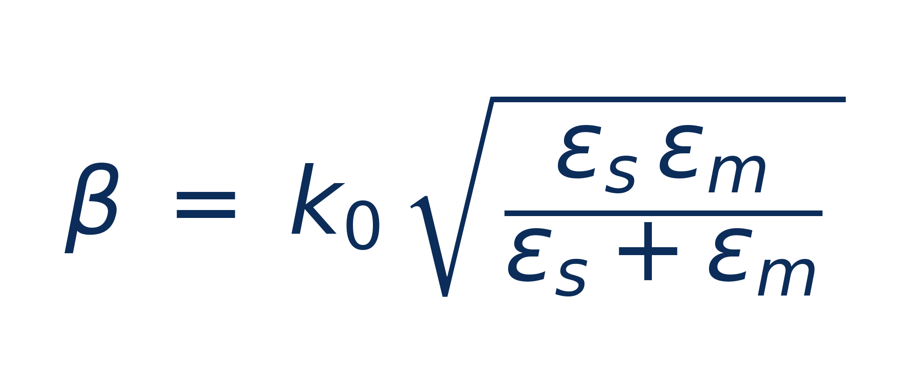
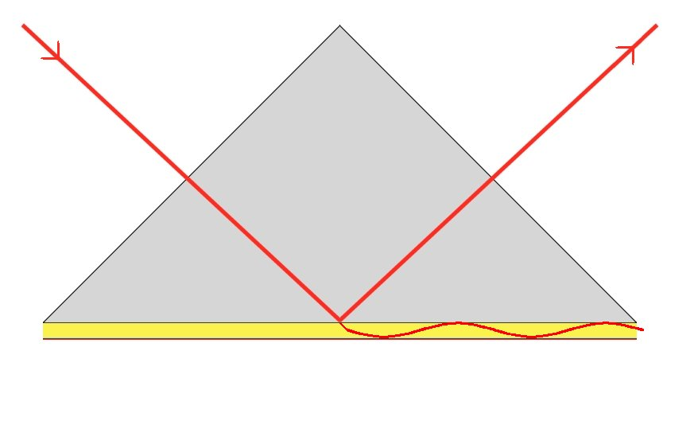
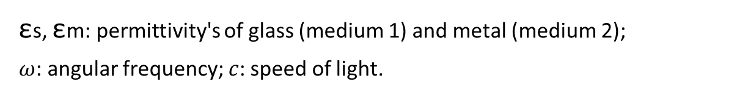
EXCITATION CONDITIONS & CONFIGURATIONS
Phase-Matching Condition
▸ Light must be p-polarized (TM).
▸ In-plane photon momentum must equal plasmon momentum.
Dispersion Relation
(1)
Fig. 2 — Otto configuration: a thin air gap separates the prism from the metal film. [Tomio, CC BY-SA 3.0]
εs​, εm​: permittivity's of glass (medium 1) and metal (medium 2); $ω$: angular frequency; $c$: speed of light.
Prism-Coupling Configurations
▸ Otto configuration — thin air gap between prism and metal film.
▸ Kretschmann–Raether — metal film deposited directly on prism; most widely used; foundation for SPRi.
Fig. 3 — Kretschmann–Raether configuration: the metal film is deposited directly on the prism base. [Wikimedia Commons, Public Domain]
PHYSICS OF SPR
03
IITR
Seminar

Slide 4
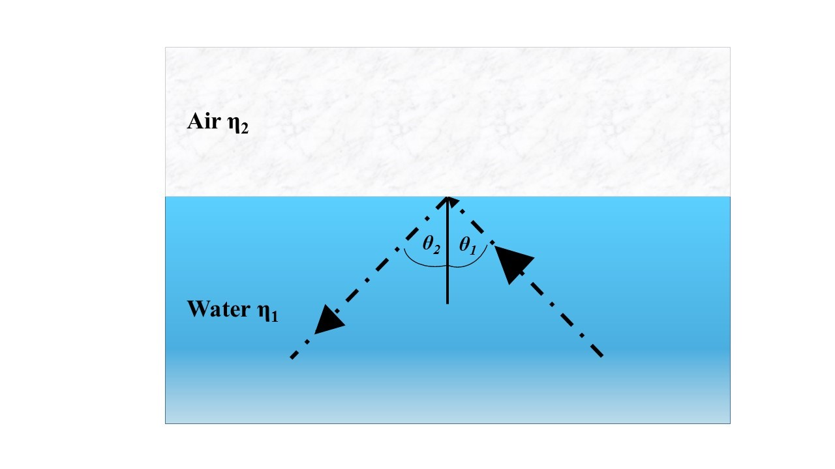
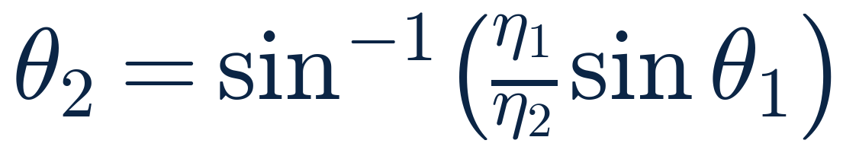
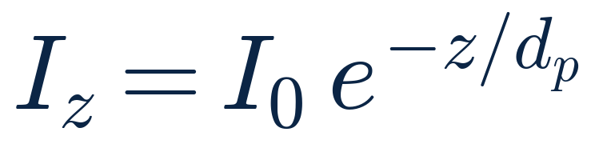
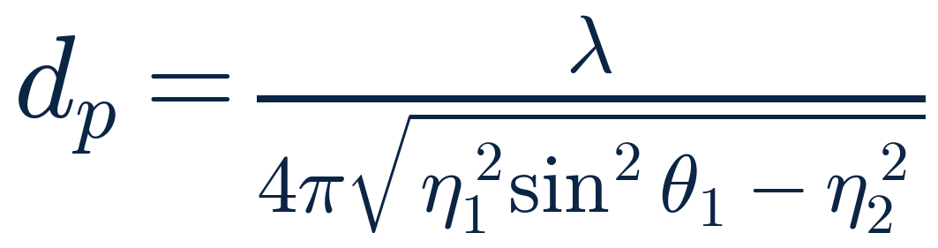
PHYSICS RECAP — TIR & THE EVANESCENT WAVE
Total Internal Reflection (Snell's Law)
▸ Light travels from high → low refractive index medium (η₁ > η₂).
▸ Above the critical angle → fully reflected:
(2)
Evanescent Wave
▸ A small field intensity leaks into medium 2 during TIR; decays exponentially with depth z:
Fig. 5 — Total internal reflection geometry: incident and reflected rays in the denser medium (water, η₁) with the rarer medium (air, η₂) above.
(3)
Penetration Depth
(4)
Key Insight
Resonant coupling between the evanescent field and the collective electron oscillation of the metal surface transfers energy to surface plasmons — producing a sharp dip in reflected intensity, the SPR signal.
Typical penetration depth ~ a few hundred nm.
Coupling to surface plasmons: when the evanescent field's frequency matches the collective electron oscillation, energy is transferred to SPPs → resonance dip in reflected intensity.
PHYSICS OF SPR
05
Seminar

Slide 5
SPR IMAGING (SPRi) — CONCEPT
From single-point SPR to two-dimensional imaging
Conventional SPR
SPRi Approach
Key Advantages
▸ Angle-swept measurement
▸ Single spot per acquisition
▸ Limited multiplexing capability
▸ Fixed angle + collimated beam
▸ Extended illumination area
▸ Every CCD/CMOS pixel acts as an independent sensor
▸ Hundreds of spots in parallel
▸ High-throughput label-free biosensing
▸ Spatial + temporal info in one experiment
Foundation
▸ Built on the Kretschmann configuration.
▸ Same underlying physics: total internal reflection + momentum matching at the prism base.
FROM SPR TO IMAGING
04
Seminar

Slide 6
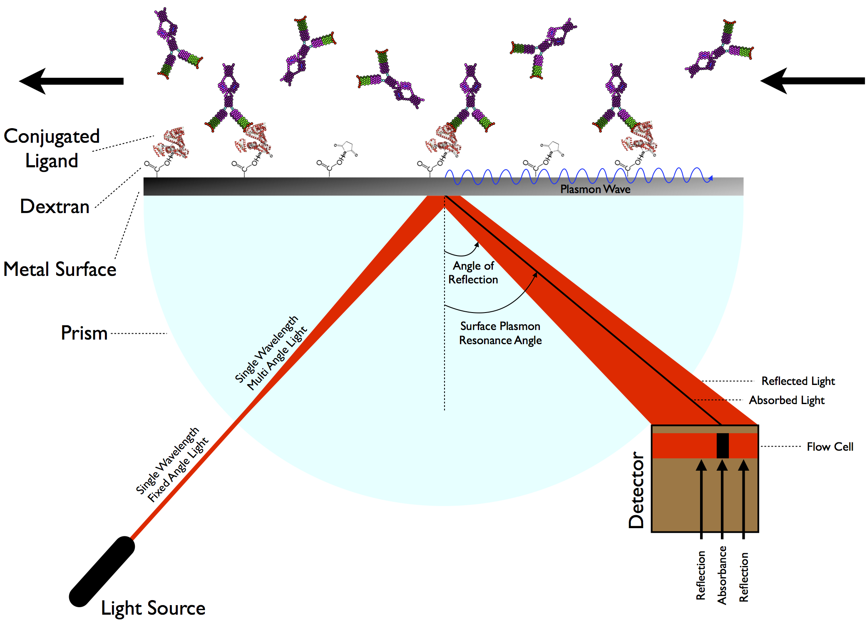
SPRi INSTRUMENTATION
Working Principle
▸ Combines SPR physics with 2D image capture via a CCD camera.
▸ Records spatially-resolved reflectivity changes across the entire sensor surface.
Core Components
Component | Function
Light source | He–Ne laser — monochromatic, low-divergence
Prism | Glass slide coupling for momentum matching (Kretschmann)
Sensor chip | ~50 nm Au/Ag film on glass; biofunctionalized surface
Detector | CCD / CMOS camera captures the reflected beam
Supporting Optics
Fig. 6 — Complete SPRi instrumentation schematic: light source, prism, biofunctionalized Au surface (with conjugated ligands on a dextran matrix), flow cell, and detector capturing the reflected beam at the SPR angle.
▸ Polarizer → ensures p-polarized (TM) light.
▸ Beam expander → uniform illumination over the sensor area.
▸ Focusing lenses → image formation on the detector.
▸ Filters & rotating stage → angle tuning and noise reduction.
Configuration Variants
▸ Prism-based SPRi (Kretschmann) — robust, widely used.
▸ Objective-based SPRi — high-NA objective → higher spatial resolution; microscope-compatible.
INSTRUMENTATION
06
Seminar

Slide 7

SPRi — STATE OF THE ART (OVERVIEW)
Where the field stands today
▸ SPRi has evolved from a proof-of-concept imaging tool into a mature, multiplexed biosensing platform.
▸ Modern systems achieve sub-nanomolar sensitivity with hundreds–thousands of spots per chip.
▸ Active research is pushing toward single-molecule, single-cell, and single-nanoparticle resolution.
Key Advancement Directions
01
02
03
04
05
Sensitivity
Resolution
Information
Hybrid
Applications
Nanostructures, phase-sensitive detection
Objective-coupled & nanoscale SPRi
Hyperspectral, phase, multi-parametric imaging
SPRi + electrochemistry, fluorescence, MS
Diagnostics, drug discovery, single-cell biology
STATE OF THE ART
07
Seminar

Slide 8
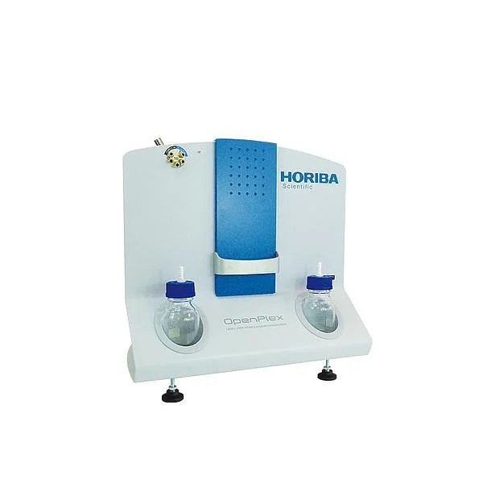
HORIBA OPENPLEX — PRISM-BASED SPRi
Working Principle
▸ Kretschmann, fixed-angle SPRi on a functionalised biochip; large arrays in parallel.
▸ Dual output: kinetic sensorgrams + a 2D SPRi difference image (bright = binding).
Detection Cycle (A → D)
▸ A — Baseline: ligands immobilised on the biochip; no interaction, flat SPRi signal.
▸ B — Association: sample injected → binding shifts the plasmon curve; reflectivity rises and interacting spots glow white in the difference image.
▸ C — Dissociation: complexes dissociate as sample is washed out; reflectivity falls; spots darken in the difference image.
▸ D — Regeneration: residual complexes stripped; plasmon curve returns to baseline. Limits: narrow dynamic range; LOD ~5 pg/mm² (10–50× weaker than MX96); small molecules need amplification; 200 µL sample.
Fig. 9 — Horiba OpenPlex: prism-based SPRi instrument using Kretschmann configuration for parallel monitoring of label-free molecular interactions on a single biochip.
STATE OF THE ART
08
Seminar

Slide 9
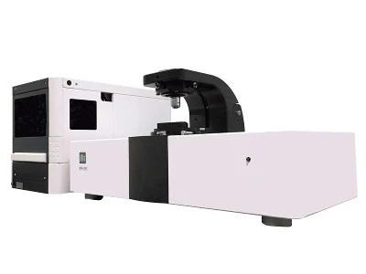
SPR MICROSCOPY — THE BI SPRM 200
Working Mechanism & Pioneering Technology
A high-performance CMOS camera captures localized binding kinetics across hundreds of regions of interest simultaneously, allowing real-time measurement directly on intact cell membranes in native physiological states.
The BI SPRm 200 is the world's first commercial Surface Plasmon Resonance Microscopy (SPRM) system, integrating label-free SPR with high-resolution bright-field optical microscopy.
Fig. 8 — BI SPRm 200 surface plasmon resonance microscopy system.
Advanced Optical Architecture
Sub-Diffraction Nanoscale Detection
Built on a stable prism-coupled Kretschmann configuration; uses a 690 nm laser to excite surface plasmons and scans incident angles from 40° to 76°, while a blue LED captures cellular phenotypic changes.
Tracks wake patterns generated when nanoparticles or pathogens act as scattering centers in plasmonic waves. These footprints appear up to 100× larger than particle size, enabling nanometer-scale binding and bacterial nanomotion monitoring.
STATE OF THE ART
09
Seminar

Slide 10
SPRi — STATE OF THE ART
Disadvantages & Technical Limitations
Signal and Sample Constraints
High susceptibility to noise and data complexity: serum-like matrices cause background fluctuations, focal drift, and nonspecific adsorption; high-dimensional image datasets require intensive post-processing or machine-learning algorithms.
Steep learning curve: more optical alignment, scattering interpretation, and custom data pipelines than standard black-box SPR instruments.
Weak intrinsic optical signals often require plasmonically active nanoparticles for enhancement.
Sample adherence constraints: cells must be grown or tethered directly onto the 50 nm gold-coated sensor chip because detection relies on the evanescent field at the interface.
Key Applications
▸
Live-cell drug discovery: label-free binding kinetics on membrane proteins (GPCRs, ion channels) in native environment — addresses >50% of drug targets.
▸
Single-cell heterogeneity mapping: per-cell affinity quantification for personalized medicine and resistant-subpopulation analysis.
▸
Pathogen & nanoparticle detection: single virus, exosome, and bacterial detection via plasmonic wake patterns; enables rapid antibiotic susceptibility testing.
▸
Therapeutic antibody characterization: direct measurement on live cells (e.g., Rituximab–CD20, anti-HER2) — bridges purified-protein SPR and cell-based functional assays.
STATE OF THE ART
10
Seminar

Slide 11
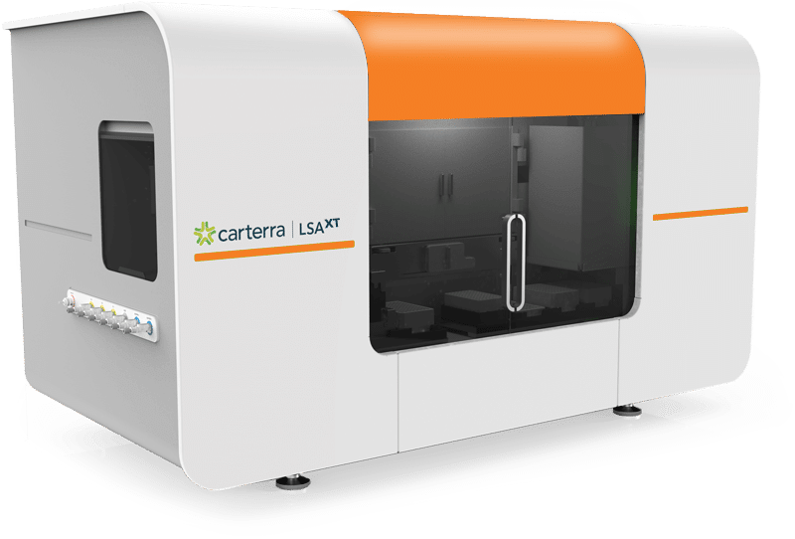
CARTERRA HIGH-THROUGHPUT DPR (HT-SPR)
Working Principles
▸
Dual-mode microfluidics & SPRi: integrates SPR imaging with Continuous Flow Microspotting.
▸
Array fabrication: 96-channel printhead forms isolated micro-channels and immobilizes up to 384 active ligand spots.
▸
One-on-many analyte delivery: a Single Flow Cell delivers a pulse-free analyte stream across the 384-spot array simultaneously.
▸
Bidirectional flow: reagents cycle back and forth, preventing denaturation, reducing sample consumption, and allowing extended contact times.
Fig. 10 — Carterra LSA-XT high-throughput SPR platform.
Key Applications
▸
High-throughput kinetics & affinity: simultaneous kinetic analysis of up to 1,152 antibodies in one unattended run.
▸
Large-scale epitope binning: automates sandwich and premix binning in a 384×384 pairwise format, testing up to 147,456 interactions.
▸
Complex target & biomarker screening: GPCRs, ion channels, FcγR binding profiles, and DNA Encoded Library fragment screening.
STATE OF THE ART
10
Seminar

Slide 12
CS-SPRi — THE TEMPORAL-RESOLUTION BOTTLENECK
Why conventional SPRi cannot reach microsecond timescales — and the hardware tradeoffs that lock it in
Conventional Strengths
The Hardware Tradeoff
The Consequence
▸ Real-time, label-free, in-situ image detection.
▸ High spatial resolution + high sensitivity in biosensing & chemical sensing.
▸ Every camera pixel acts as an independent reflectivity sensor.
▸ Three-way conflict: frame rate , spatial resolution, sensitivity.
▸ Higher frame rate → pixel resolution must be sacrificed.
▸ Shorter exposure → fewer photons per frame → SNR collapses.
▸ Hardware ceiling pins typical SPRi cameras at only a few Hz at full resolution.
▸ Microsecond dynamics — EDLs, ion polarization — stay invisible.
▸ Faster cameras exist, but cost, ROI & SNR penalties rule them out.
Working Principle
▸ CS is a framework that allows signals to be recovered at sampling rates.
▸ CS recovers a signal below the Nyquist rate when it is sparse in some basis — applied here to fast SPRi reflectivity transients.
▸ A custom FPGA gates camera exposure on a quasi-Bernoulli matrix Φ — converting an unaffordable temporal sampling problem into a solvable inverse problem.
STATE OF THE ART
13
Seminar

Slide 13
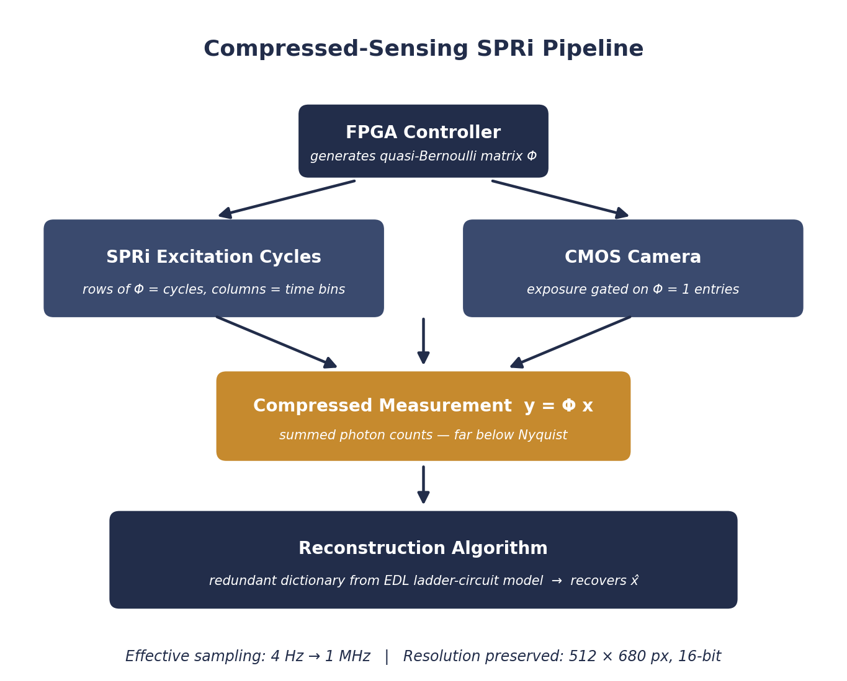
CS-SPRi — THE COMPRESSED-SENSING METHOD
Pipeline Steps
Step | What Happens
1. Measurement matrix | FPGA generates quasi-Bernoulli Φ — rows=cycles, cols=time bins
2. Gated exposure | Camera captures frames only where Φ = 1; intensities are summed
3. Compression | Result: a compressed vector y = Φx, far below Nyquist rate
4. Reconstruction | Redundant dictionary (EDL ladder-circuit model) recovers x̂
Fig. 10 — CS-SPRi pipeline: an FPGA controller gates the camera exposure on a quasi-Bernoulli matrix Φ; the compressed measurement y = Φx is inverted with a redundant dictionary built from an EDL ladder-circuit model.
STATE OF THE ART
14
Seminar

Slide 14
SPRi — Algorithim
Pipeline Steps
Step | What Happens
1. Background Subtraction | • Compares the current sensor frame to a baseline reference frame pixel-by-pixel. • Calculates the dip depth: . • Identifies the dip region with an overflow_flag (asserted if ). • Latency: 1 clock cycle per pixel (fully pipelined).
2. Centroid Accumulation | • Sequentially sums the weighted pixel indices across the 1024-pixel frame. • Accumulates the weighted index: (32-bit register). • Accumulates total weight: (22-bit register). • Latency: 1024 clock cycles per frame.
3. Restoring Division | • Resolves the division on-chip using a sequential 32-cycle restoring divider. • Computes the final 10-bit integer centroid: . • Protects against division-by-zero (defaults to 0 if no dip is detected). • Latency: 32 clock cycles.
4. Pipeline Orchestration | • Handshakes via simple control signals: starts on start, asserts busy, and pulses done when finished. • Total processing latency per frame: 1057 clock cycles.
STATE OF THE ART
09
Seminar

Slide 15
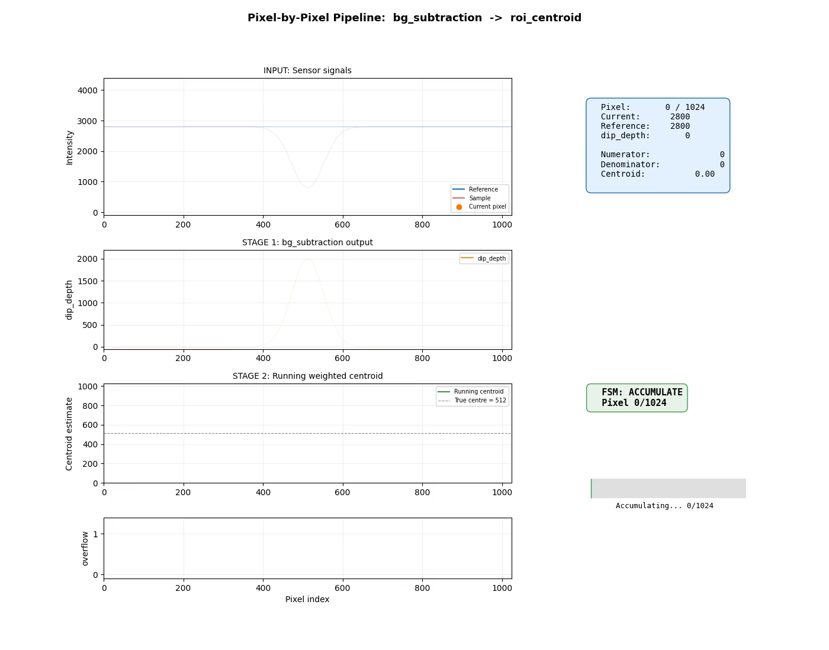
SPRi — Algorithim
STATE OF THE ART
10
Seminar

Slide 17
CS-SPRi — RESULTS & FUTURE APPLICATIONS
Microsecond-resolved interfacial dynamics — and what they unlock in biology and energy materials
Aqueous Electrolyte
Ionic Liquid
Future Biomedical Reach
▸ NaCl solution: fast EDL dynamics resolved at the electrode interface.
▸ Time constant τ = 1.4 ms — ion exchange & transport in the EDL.
▸ [BPY]BF₄ ionic liquid: fast ion-polarization transient resolved.
▸ Transient timescale: 187 µs
▸ Enzyme catalysis & single-molecule turnover events.
▸ DNA & protein folding pathways resolved in real time.
▸ Drug–receptor binding kinetics & neuronal action potentials.
The Significance
▸ CS-SPRi shifts the bottleneck from camera hardware to algorithms — a software-side path forward for the whole field.
▸ Same optical bench, same chip, same sensitivity — yet six orders of magnitude faster in time.
STATE OF THE ART
15
Seminar

Slide 18
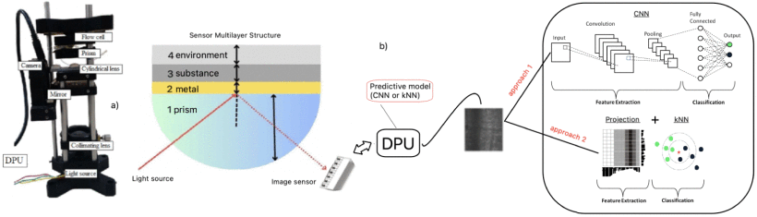
CNN and K-NN Methods for Image-Response Recognition in Surface Plasmon Resonance Sensors
Working Principle
Digital Processing Pipeline
The captured SPR images are fed into a Digital Processing Unit (DPU) which runs predictive models to classify the substance. The paper evaluates two distinct computational approaches for this:
The k-Nearest Neighbors (k-NN) Approach
This is a shallow machine learning method that relies on handcrafted feature extraction (specifically, projection histograms).
For an image f(x,y) with an M x N resolution, the algorithm calculates the vertical projection (VP) and horizontal projection (HP) by summing pixel intensities across rows and columns.
The position of the minimal vertical projection (P_V) directly reflects the resonance position in the image.
This position, combined with its corresponding horizontal value (P_H), creates a 2D coordinate point used by the k-NN algorithm to cluster and classify the data.
The Convolutional Neural Network (CNN) Approach
This deep learning method utilizes a fine-tuned MobileNetV3 architecture via transfer learning.
Unlike the k-NN method, the CNN does not require manual feature extraction. It automatically identifies discriminative spatial patterns and features directly from the raw SPR images.
It utilizes depth wise and pointwise convolutions to process the visual data and map the optical response to a specific refractive index class.
Fig. a) Photograph of the experimental set-up. b) Illustration of the multilayer structure of the intelligent SPR sensor with predictive model. dual approach based on deep (CNN) or machine (k-NN) learning algorithms. image projection histogram feature used for image representation.
STATE OF THE ART
16
Seminar

